Slide 1
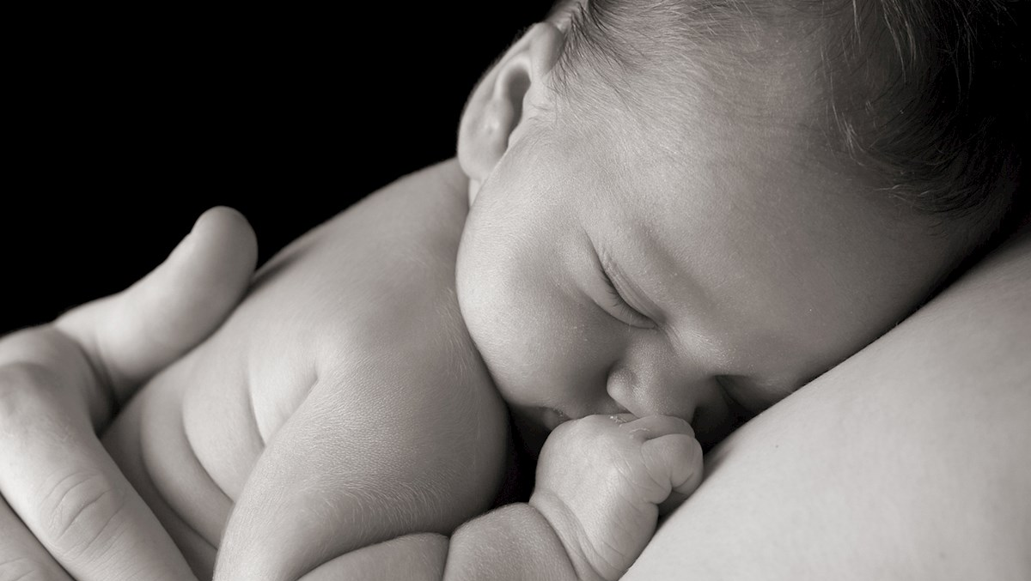
BIO-311 Neuroscience
The somatosensory system

Slide 2
Summary
The somatosensory system:
Touch and proprioception
Mechanoreceptors
Touch receptor types
Somatosensory receptive fields & tactile acuity
Touch and proprioception neural pathways
Somatotopy & homunculus
Plasticity of the somatotopic map in the context of amputation

Slide 3
The somatosensory system
The somatosensory system mediates a range of sensations including:
          Touch, pressure, vibration
              Position and movement of limbs (proprioception)
              Heat, cold, itch, pain (unit 6)
These different modalities have different:
Receptor types (receptive field)
Fiber types (speed of conduction)
Neural pathways
Notes:
The bigger the fiber, the more myelinated the fiber, the faster the conduction
Adaptive relevance of speed (e.g. rapidly react to painful stimuli)

Slide 4
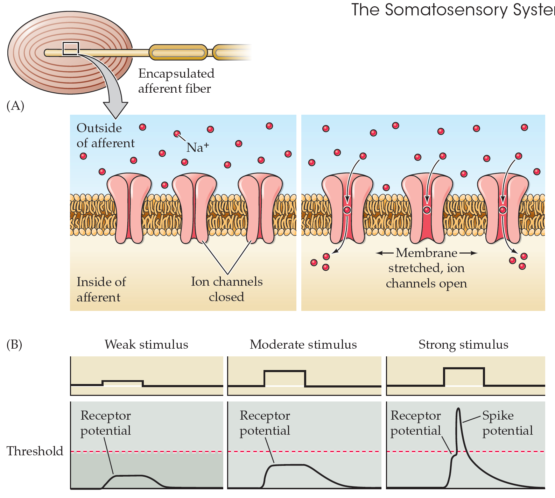
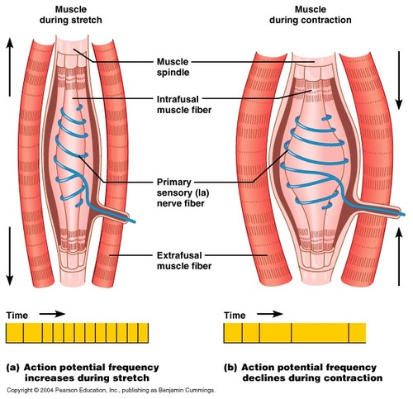
Mechanoreceptors
Skin receptors
Muscle spindle

Slide 5
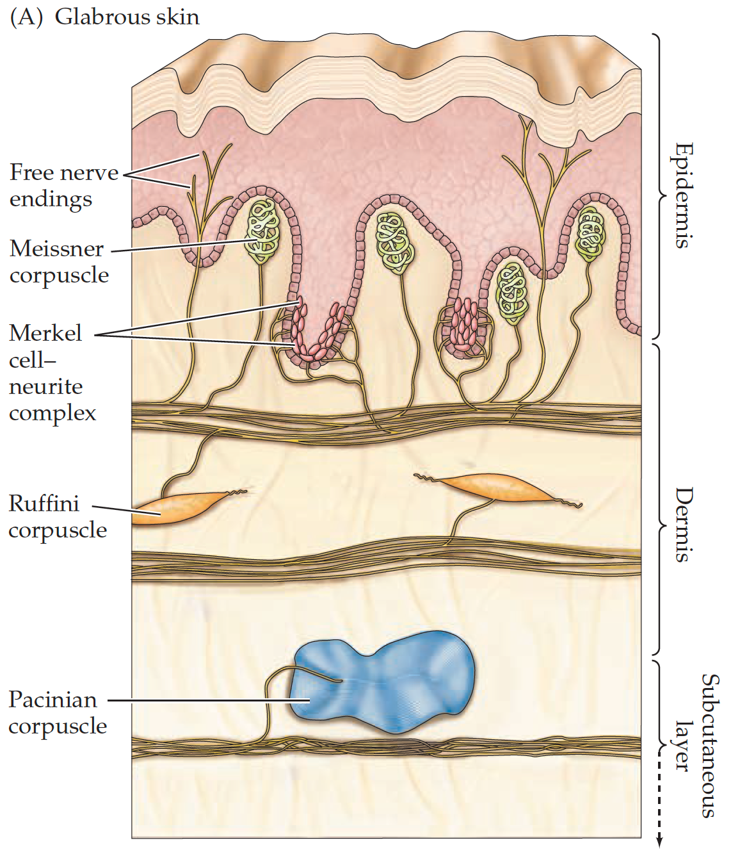
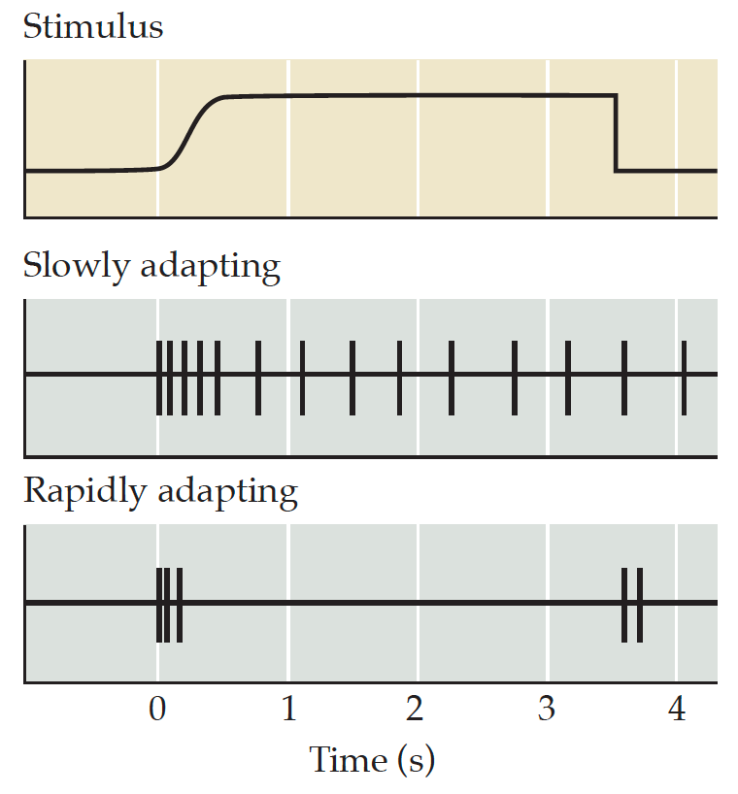
Receptor types
The different receptor types are sensitive to different tactile stimuli:
Range of vibration frequencies (texture)
Spatial resolution (tactile acuity)
Slowly adapting (sense shapes)
Rapidly adapting (sense movements)

Slide 6
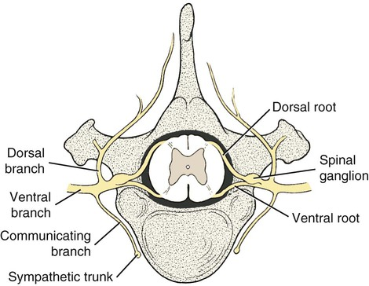
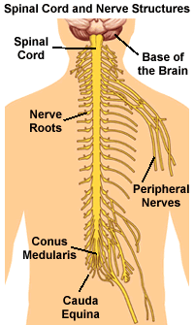
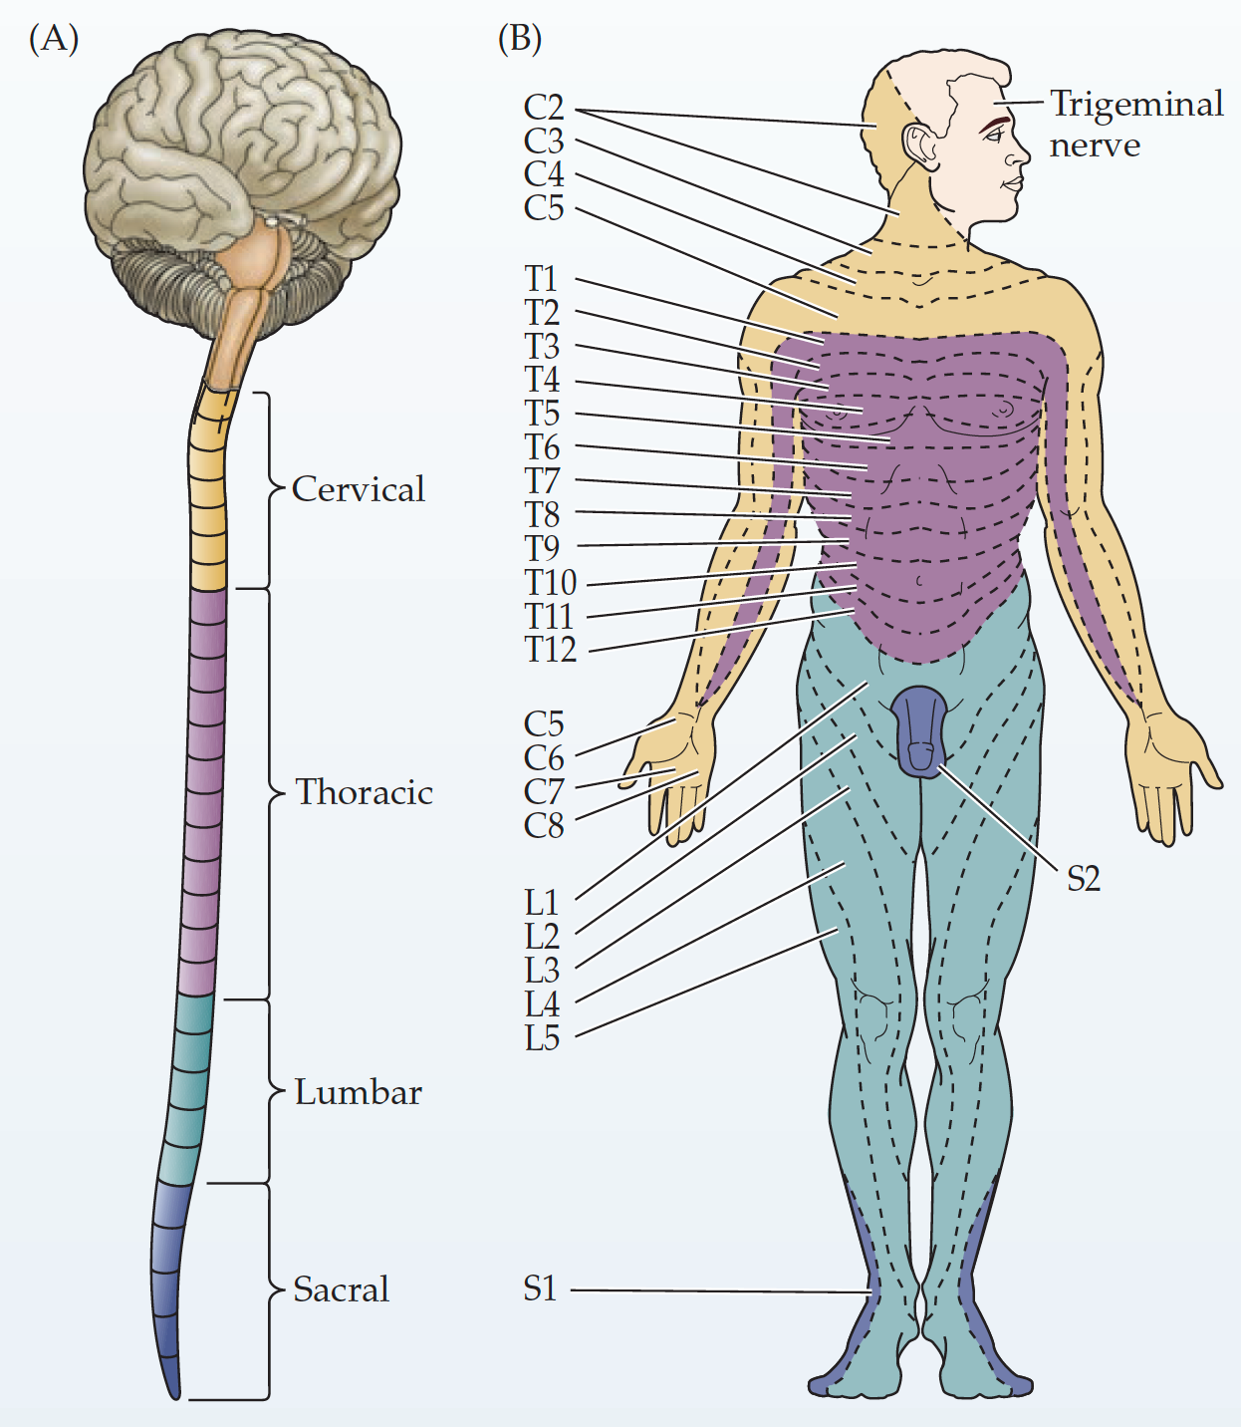
Spinal cord and peripheral nerves
Afferent sensory fibers travel to the brain via the spinal cord
Each «slice» (dermatome) of the human body is innervated by one pair of spinal nerves
Notes:
In between each vertebrae, one bundle of nerves come out of the spinal cord on both sides and form a dorsal root ganglion (DRG)

Slide 7
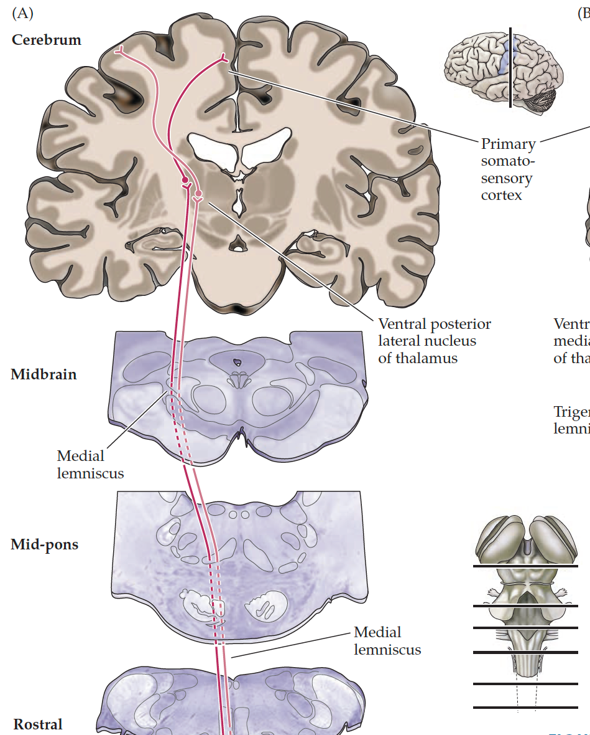
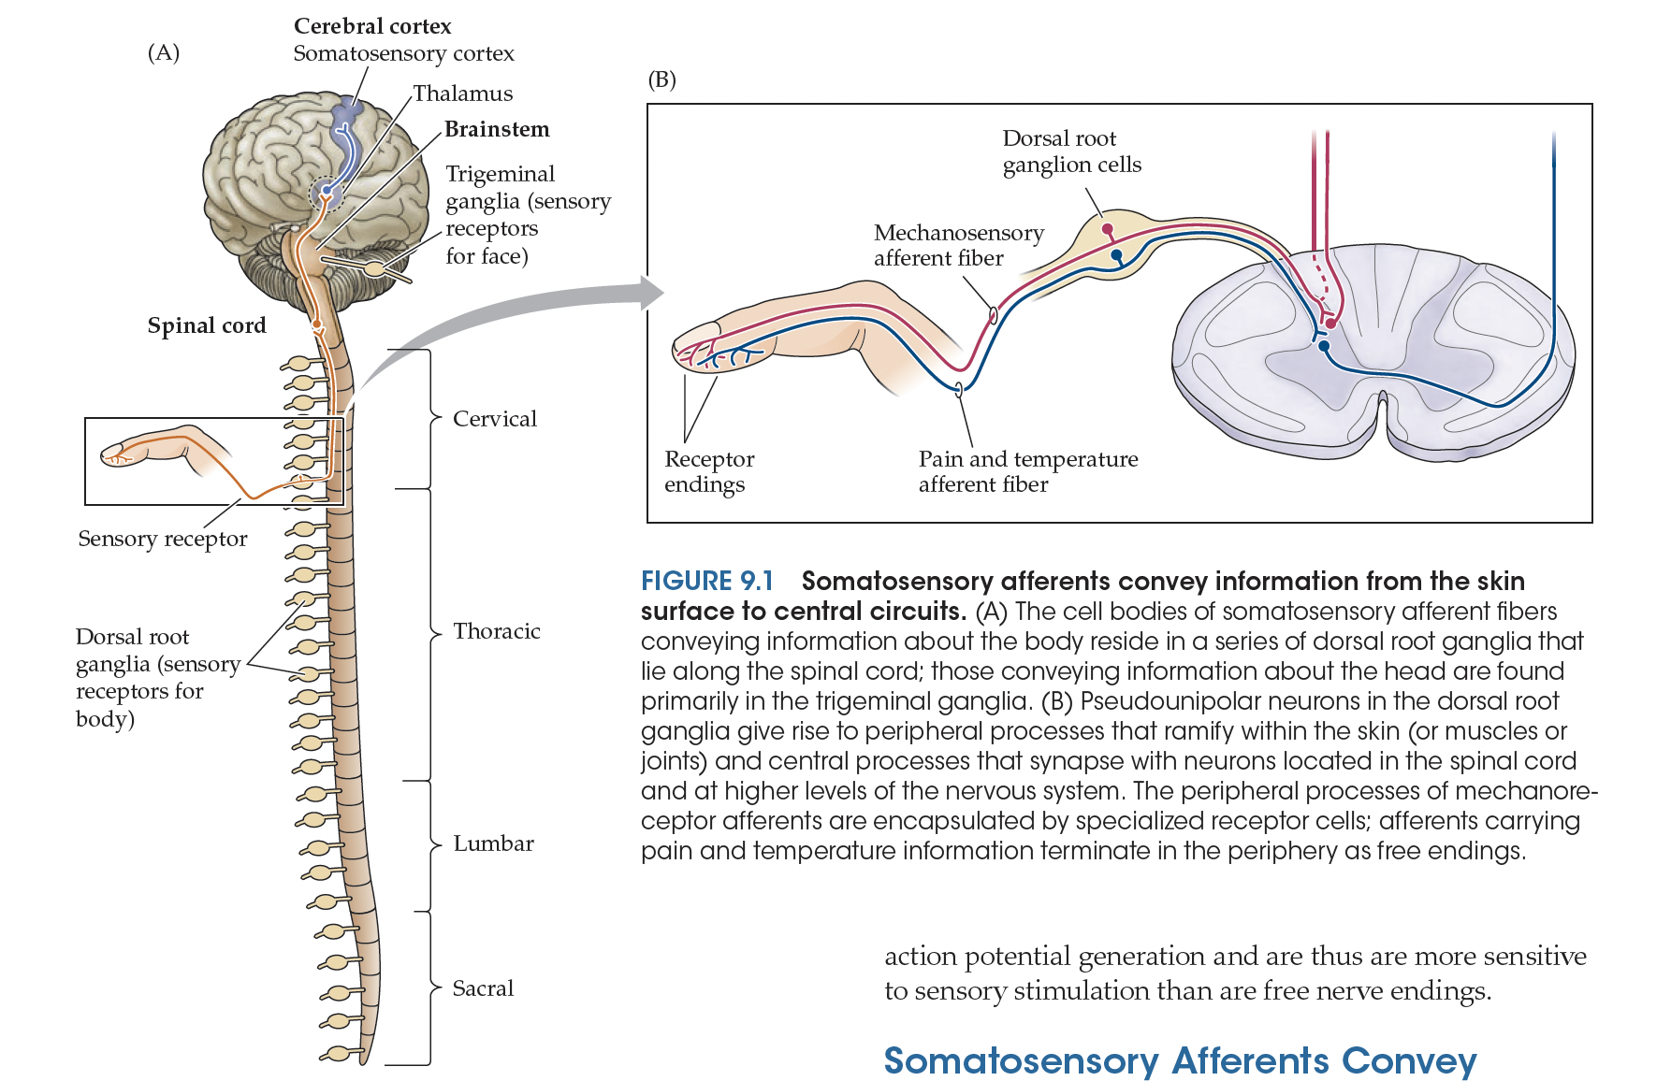
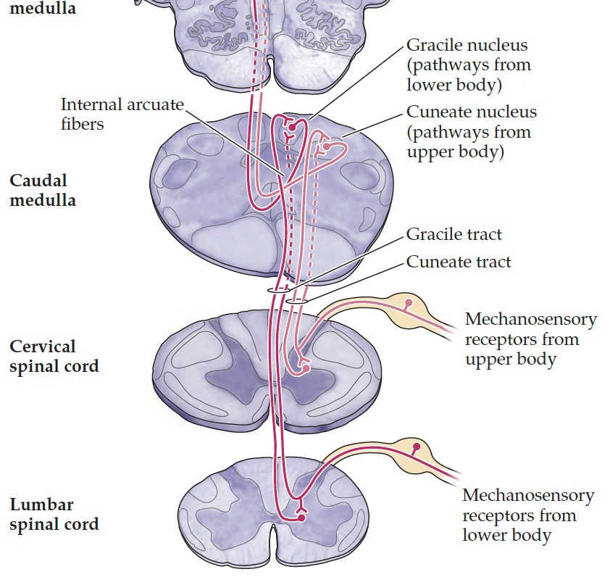
Neural pathway of touch
Primary sensory neuron: Peripheral to brainstem with cell body in DRG
Secondary sensory neuron: Brainstem to thalamus via the medial lemniscus pathway
Tertiary sensory neuron: Thalamus to cortex (S1)

Slide 8
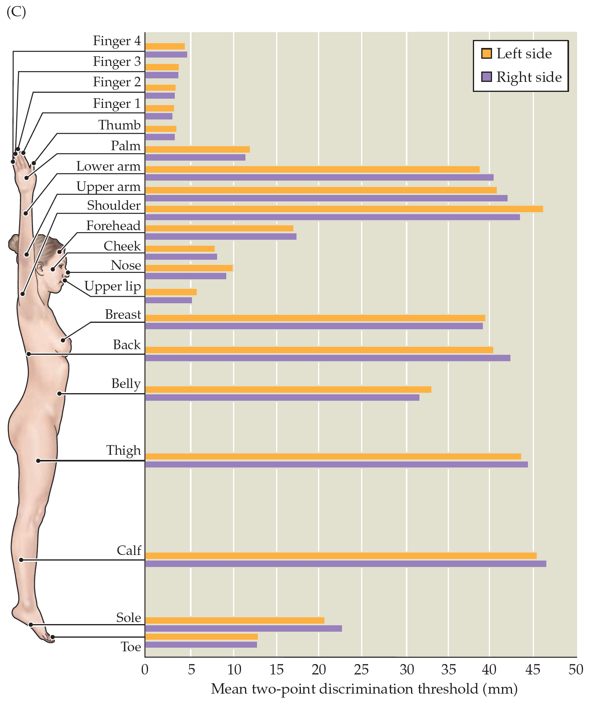
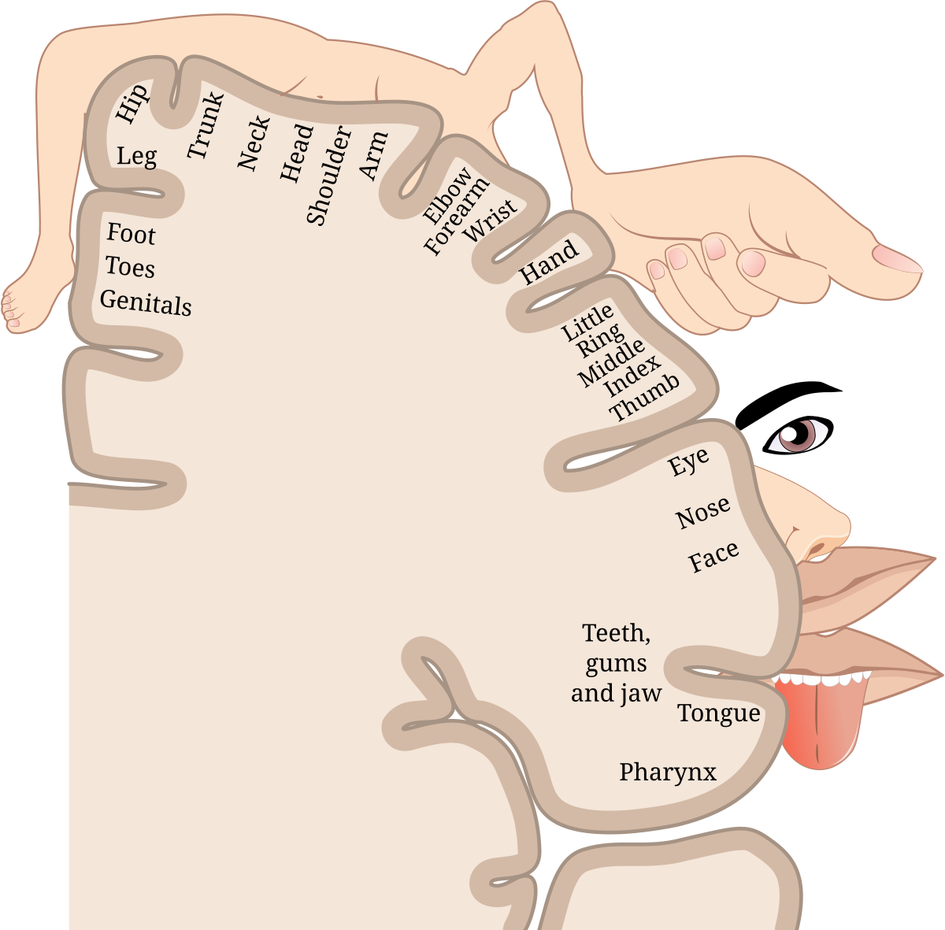
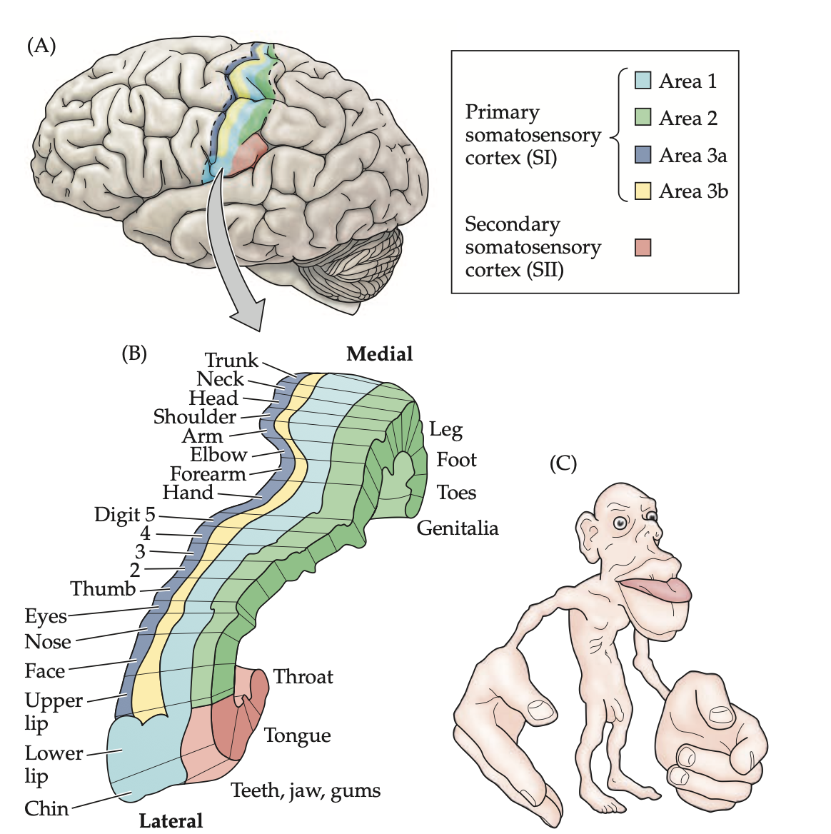
Tactile acuity and receptive fields
High local tactile acuity
= High local density of tactile receptors
= Large dedicated brain area to process all that information
= This body part is big in the homunculus !

Slide 9
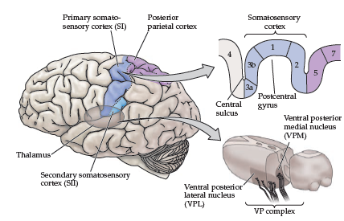
Organization of the somatosensory cortex
The somatosensory cortex is subdivided in 4 parallel areas (area 3a,3b, 1, 2) which process increasingly complex stimuli
Adjacent body parts are adjacent in the somatosensory cortex (somatotopy)

Slide 10
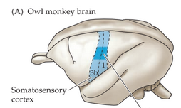
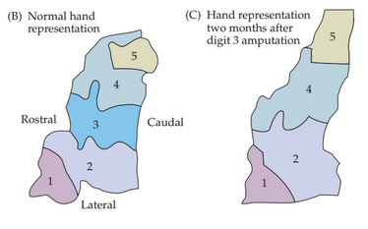
Plasticity of the somatotopic map
Experimental demonstration of somatotopic reorganization: After amputation of one digit in monkeys, the area for the amputated limb is invaded by neigboring regions

